Slide 1
Monthly Knowledge Sharing & CTF Program
Real Attack->Detect->Fix->Document (6-month repeatable cycle)
Octcome Focused program combining live exploit demos , SOC detection enginering , and monthly mini-CTFs
Exploit
Detect
Document
Goal: Turn pen-test findings into measuarble detection & remediation
Prepared by: Mohammed Sharoz
Audience : SOC Team , Security Engineering , AppSec
Date : [TBD]

Slide 2



Why This Program Exists
Pentest
Find
SOC
Detect
Leadership
Measure
Every Session outputs something that protects the company
The initiative ensures that we do not just hack and report - we turn every learned attack into a detectable and preventable outcome. SOC becomes faster and more confident during live incidents

Slide 3
How the monthly cycle works
Map
Exploit
Detect
Repeat
Test
Every week creates a documented skill + measurable defensive output

Slide 4
Red vs Blue - Advanced CTF Format
Conducted on planned Duration
Live offensive attack chain on
  Web Application
  Linux Server
  Misconfigured Cloud/ Infra (rotating)
  SOC minotrs real SIEM logs during the attack
Scoring Model
  Red Team -> exploit success + stealth
  Blue Team -> detection coverage + response quality
Every CTF produces new detections + stronger playbooks
Red Team
Blue Team
Recon
Exploit
Priv Esc
Persistence
Exfil
Every CTF run improves our defences permanently

Slide 5
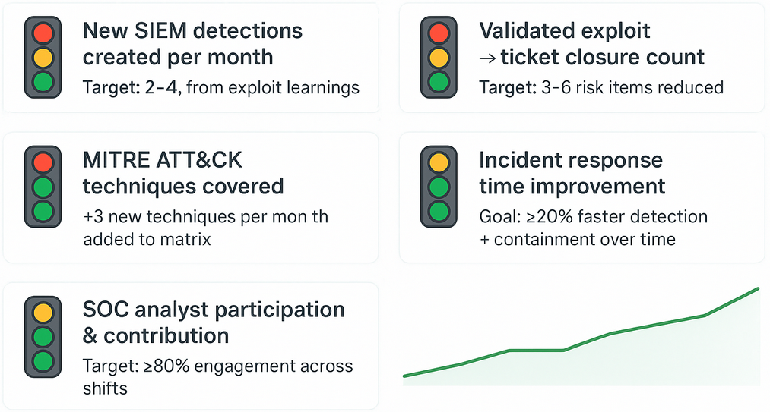
How we measure real Security Value
Every Session generates measurable operational outcomes

Slide 6
Resources to Capture & Track Value
Dashboards / Tracking
Excel for KPI tracking
Excel/Power Bi Chart for Executive Reporting
Documentation
Exploit Playbooks
Detection Login and SIEM Rules
ATT&CK mapping Rules
Knowledge Sharing
Recorded Session Videos and sharepoint page for 24/7 SOC Shifts
Lab Environment
Test Servers & Web Apps for CTF Practice and Validation
Transparency and Repeatability are built-in ensures measurable improvement at every step

Slide 7
Real Security Value Delivered
PenTest/ AppSec Gains
Exploit Paths Validated & Closed
Stronger mitgation guidance for devs
Operational SOC Improvements
Faster Detection and Containment
Reduced False Positives
Knowledge & culture
Cross-team learning & retention
24/7 coverage with recorded sessions
Leadership visibility
Measurable KPIs -> Risk reduction Stories
MITRE coverage & Detection Maturity
Every monthly session + CTF directly improves security posture and measurable defense capability

